Slide 1
Chapter-3
8085
Microprocessor Architecture and Memory Interfacing
3.1 THE 8085 MPU
Microprocessor Unit (MPU)
The term microprocessor unit (MPU) define as a group of devices (as a unit) that can communicate with peripherals, provide timing signals, direct data flow, and perform computing tasks as specified by the instructions in memory.

Slide 2
Using above description, the 8085 microprocessor can almost qualify as an MPU, but with the following two limitations:
The low-order address bus of the 8085 microprocessor is multiplexed (time-shared) with the data bus. The buses need to be demultiplexed.
Appropriate control signals need to be generated to interface memory and I/O with the 8085.
3.11 The 8085 Microprocessor
The 8085A commonly known as the 8085
It is an 8-bit general-purpose microprocessor
It is capable of addressing 64K of memory.
It has 40 pins and requires +5V power supply.
It can operate with a 3-MHz clock frequency.
It is an enhanced version of its predecessor 8080A.

Slide 3
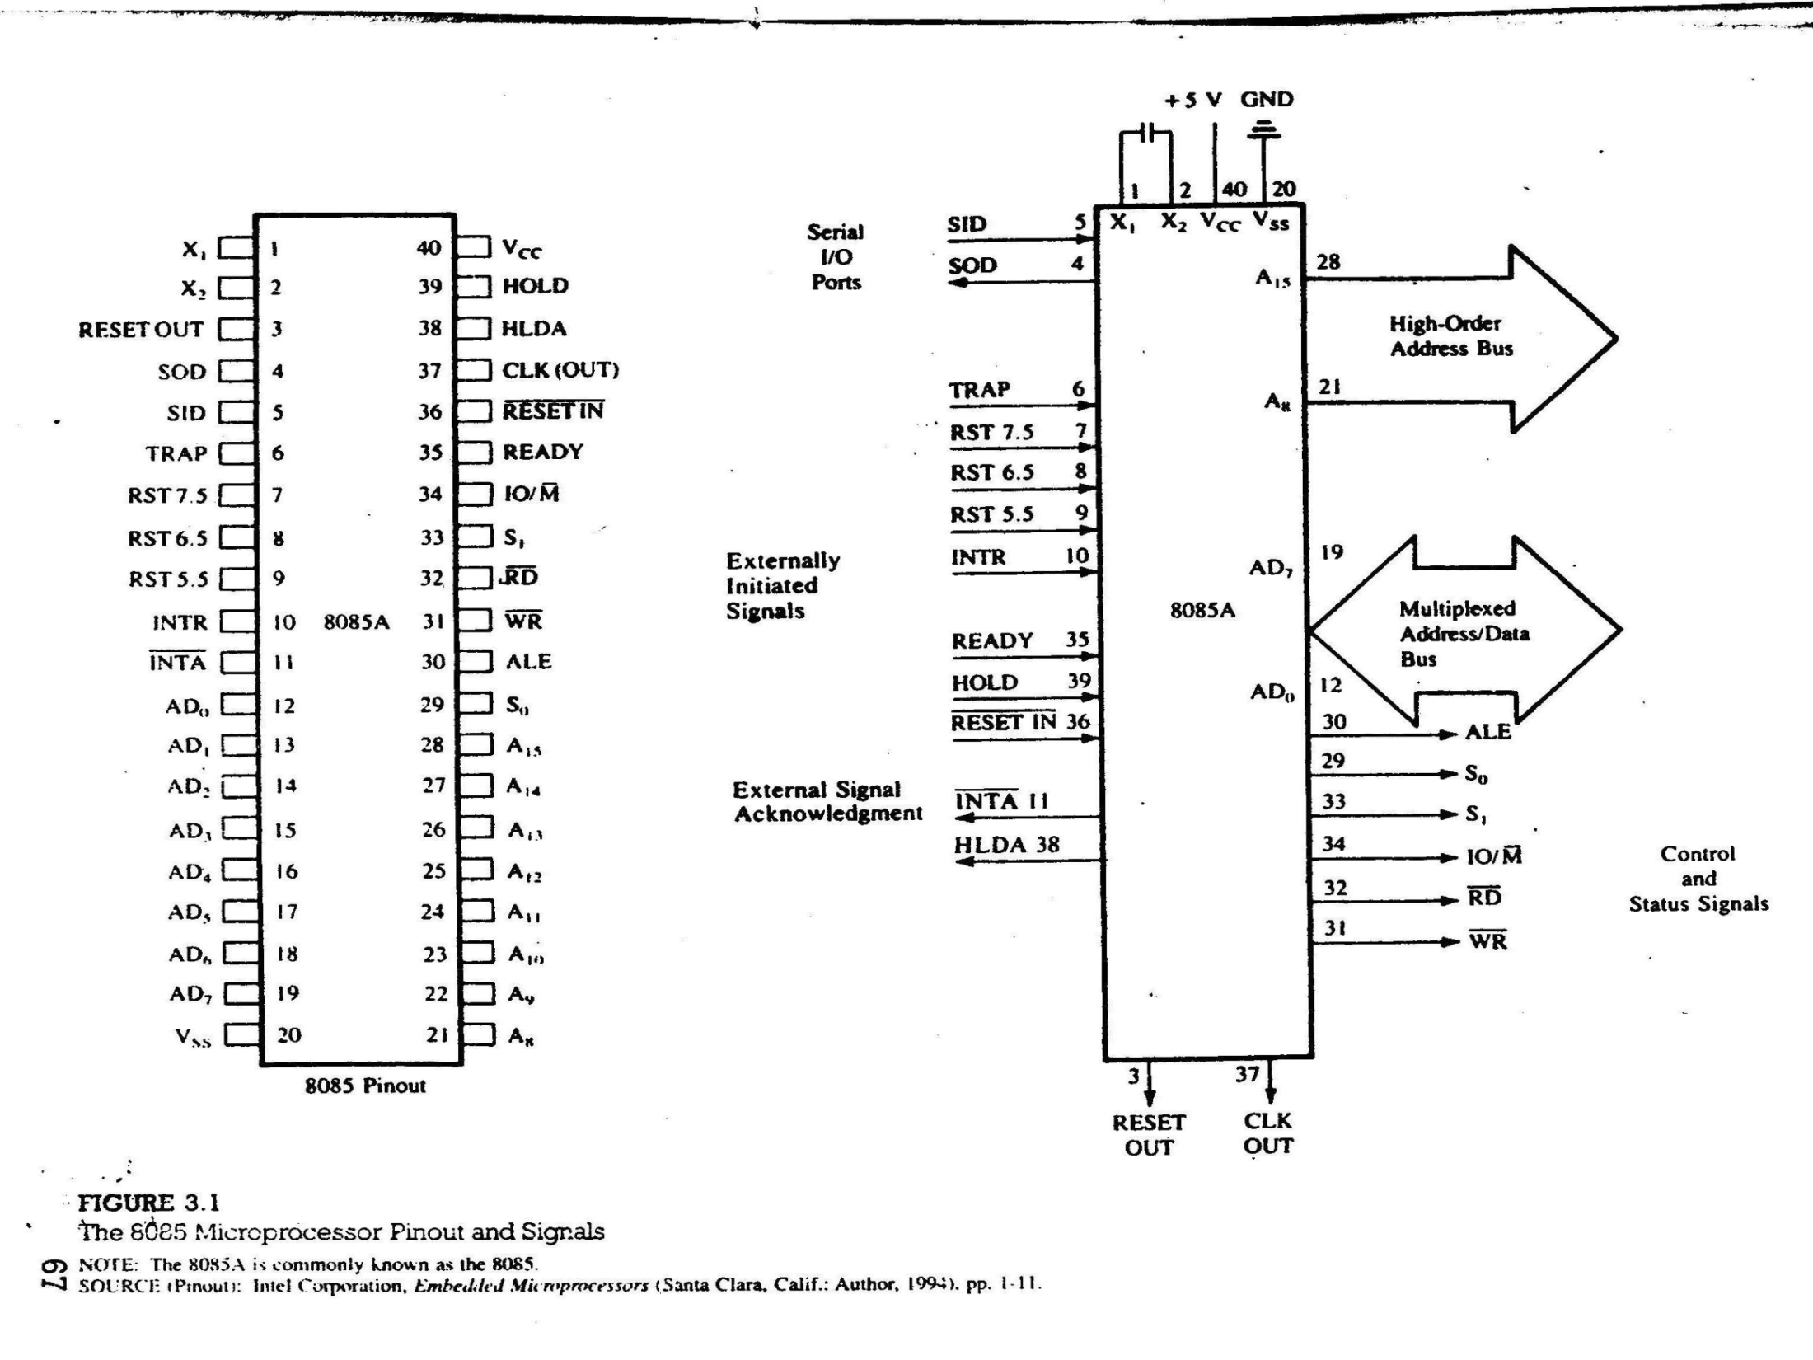

Slide 4
Figure 3.1 shows the logic pinout of the 8085 microprocessor.
All the signal can be classified into six groups:
Address bus.
Data bus.
Control and status signals.
Power supply and frequency signals.
Externally initiated signals.
Serial I/O ports.
ADDRESS BUS
A₁₅ - A₈ are unidirectional and high order address bus.
MULTIPLEXED ADDRESS/DATA BUS
AD₇ - AD₀ are bidirectional and serve a dual purpose. During instruction fetch these are used as address lines and during operand fetch these are used as data lines.

Slide 5
CONTROL AND STATUS SIGNALS
Control and status signals indicate the nature of the operation.
Control Signals: RD and WR.
Status Signals: IO/M, S₁ , and S_{0.}
Special Signal: ALE. Indicate the beginning of the operation.
RD: Low for read operation(active low).
WR: Low for write operation (active low).
IO/M: High for I/O operation (active high) and low for memory
operation (active low).
S₁ , and S₀ : Similar to IO/M and rarely used in small system.
ALE (Address Latch Enable)
This is a positive going pulse and generated every time 8085 begins an operation; it indicates that bits on AD₇ - AD₀ are address bits. This signal are used to latch the low-order address bus an generate a separate set of eight address lines; A₇ - A₀

Slide 6
EXTERNALLY INITIATED SIGNALS INCLUDING INTERRUPT
TABLE 3.2
8085 Interrupts and Externally Initiated Signals
INTR (Input)
INTA (Output)
RST 7.5 (Inputs)
RST 6.5
RST 5.5
TRAP (Input)
HOLD (Input)
HLDA (Output)
READY (Input)

Slide 7
3.12 Microprocessor Communication and Bus Timing
Example: The instruction code 01001111 (4FH-MOV C,A) is stored in memory location 2005H. Illustrate the data flow and list the sequence of events when the instruction code is fetched by the MPU.
Solution: To fetch the byte, the MPU performs the following steps:
Step 1: The program counter places the 16-bit memory address on the address bus (Figure 3.2).
Figure 3.3 shows that at T₁ the high-order address (20H) is placed on A₁₅ - A₈ and the low-order address (05H) is placed on AD₇ - AD₀ , ALE goes high, IO/M goes low.
Step 2: The control unit sends the control signal RD to enable the memory chip (Figure 3.2).
Step 3: The byte from the memory location is placed on the data bus.

Slide 8
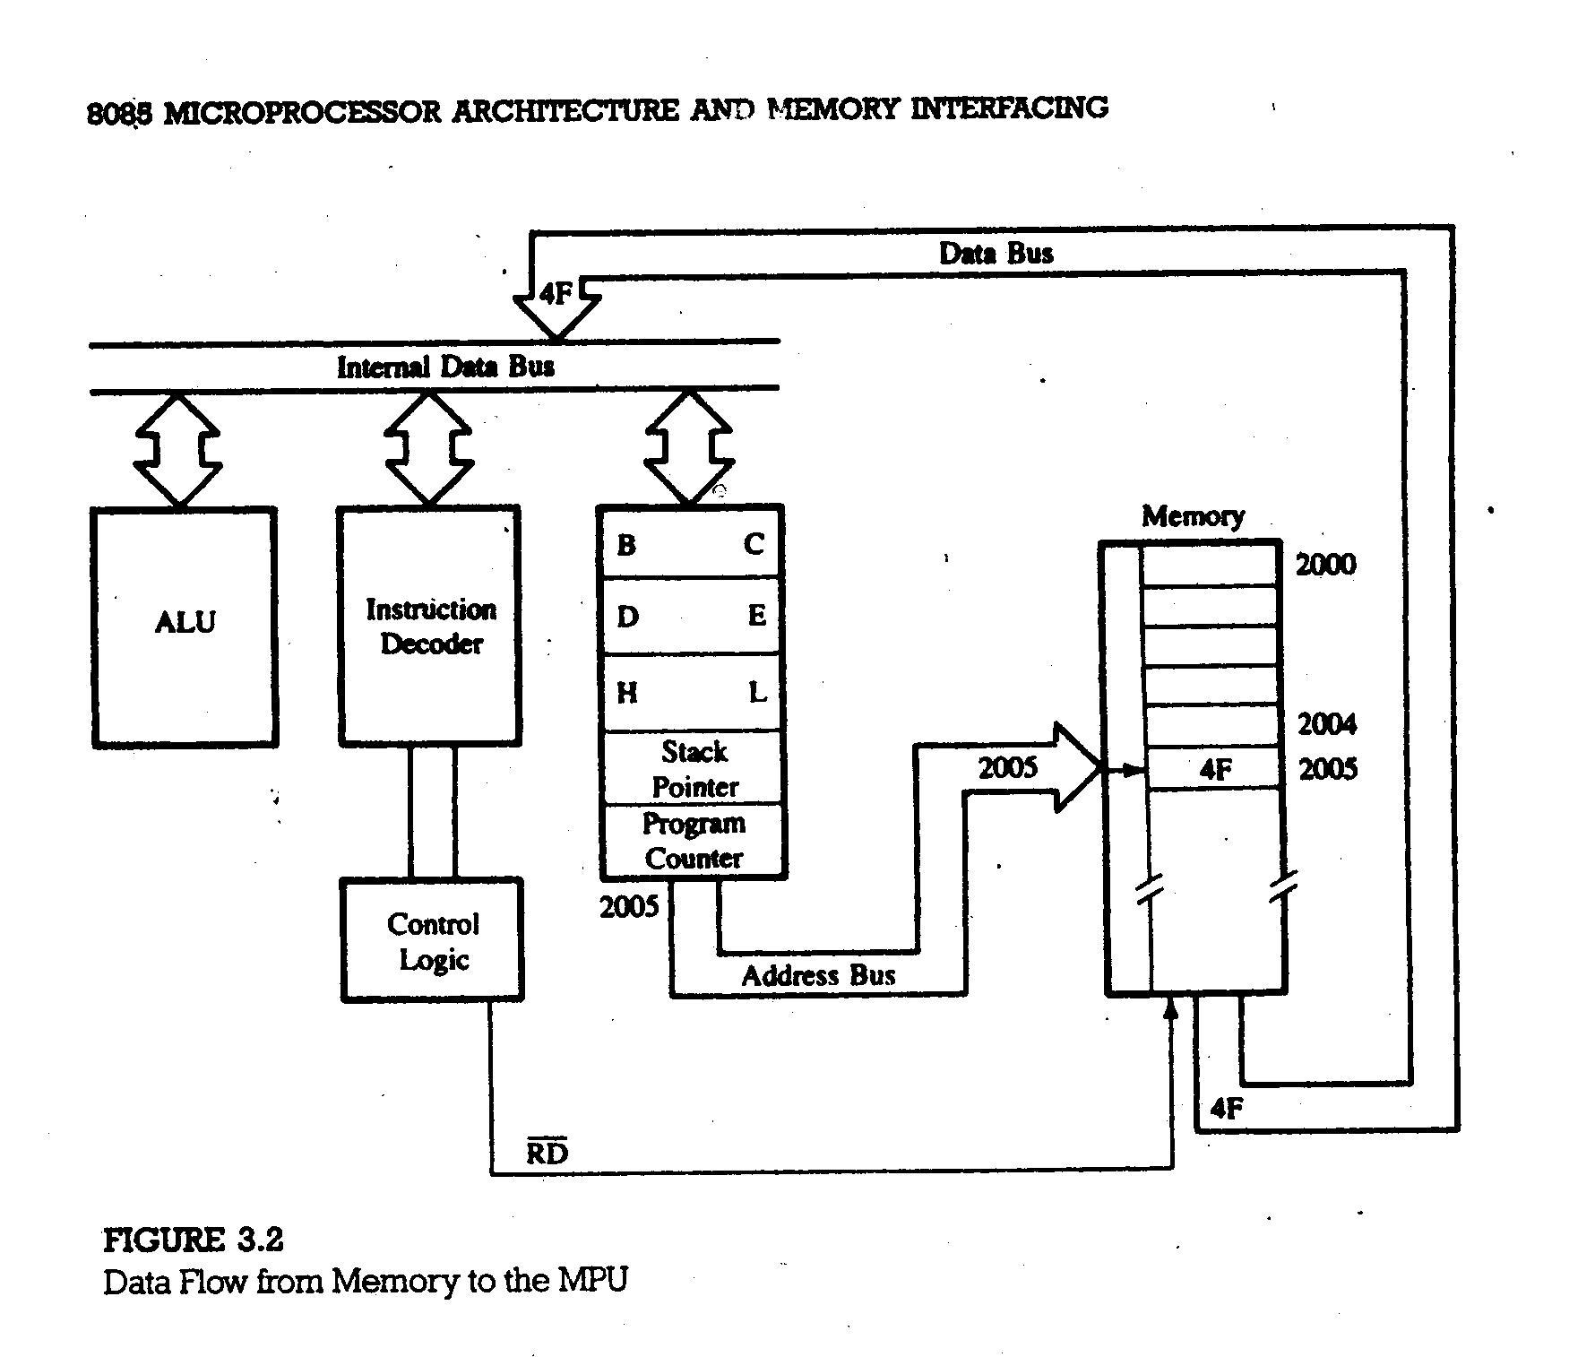

Slide 9
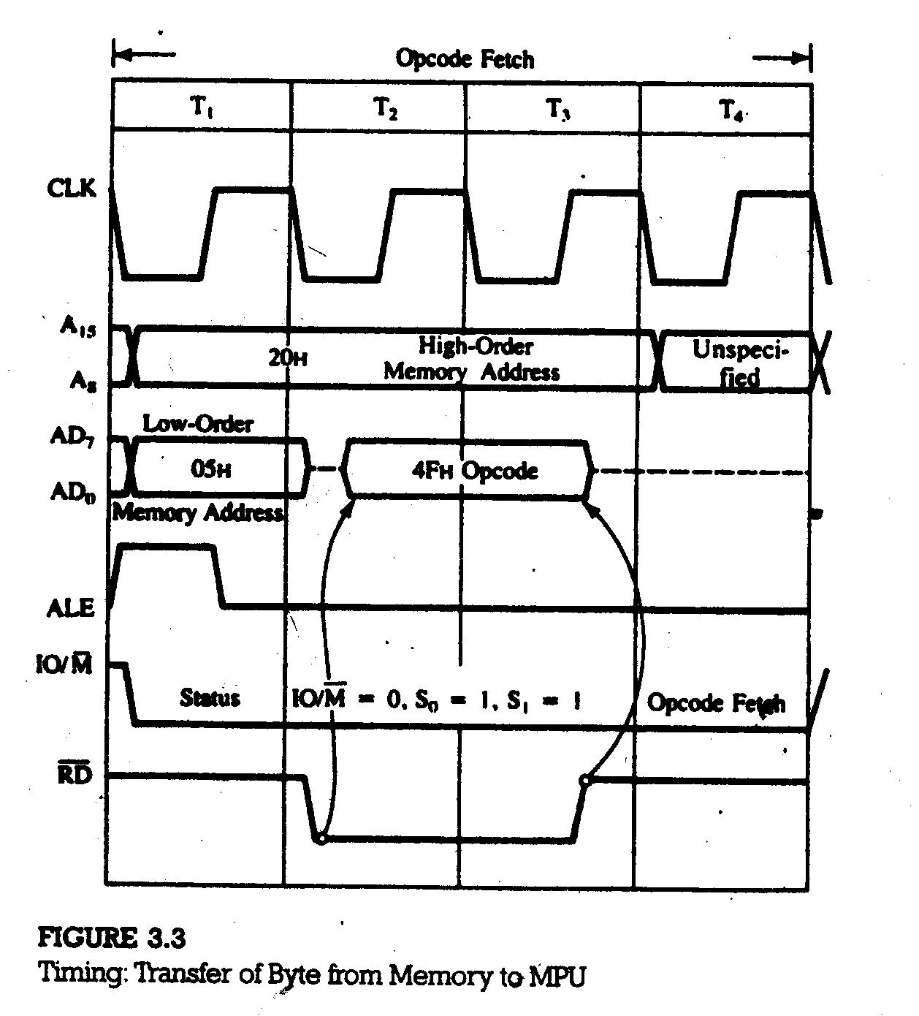

Slide 10
The RD signal causes 4FH to be placed on bus AD₇ - AD₀ (shown by arrow).
Step 4: The byte is placed in the instruction decoder of the microprocessor, and the task is carried out according to the instruction.
3.13 Demultiplexing the Bus AD₇-AD₀
Figure 3.3 shows that the address on the high-order bus (20H) remains on the bus for three clock periods (T₁ to T₃). However, the low-order address (05H) is lost after the first clock period. The address needs to be latched for identifying the memory address. Otherwise, the address 2005H will change to 204FH after the first clock period.
Figure 3.4 shows that the uses of a latch (74LS373) and the ALE signal demultiplexes the low-order bus.

Slide 11
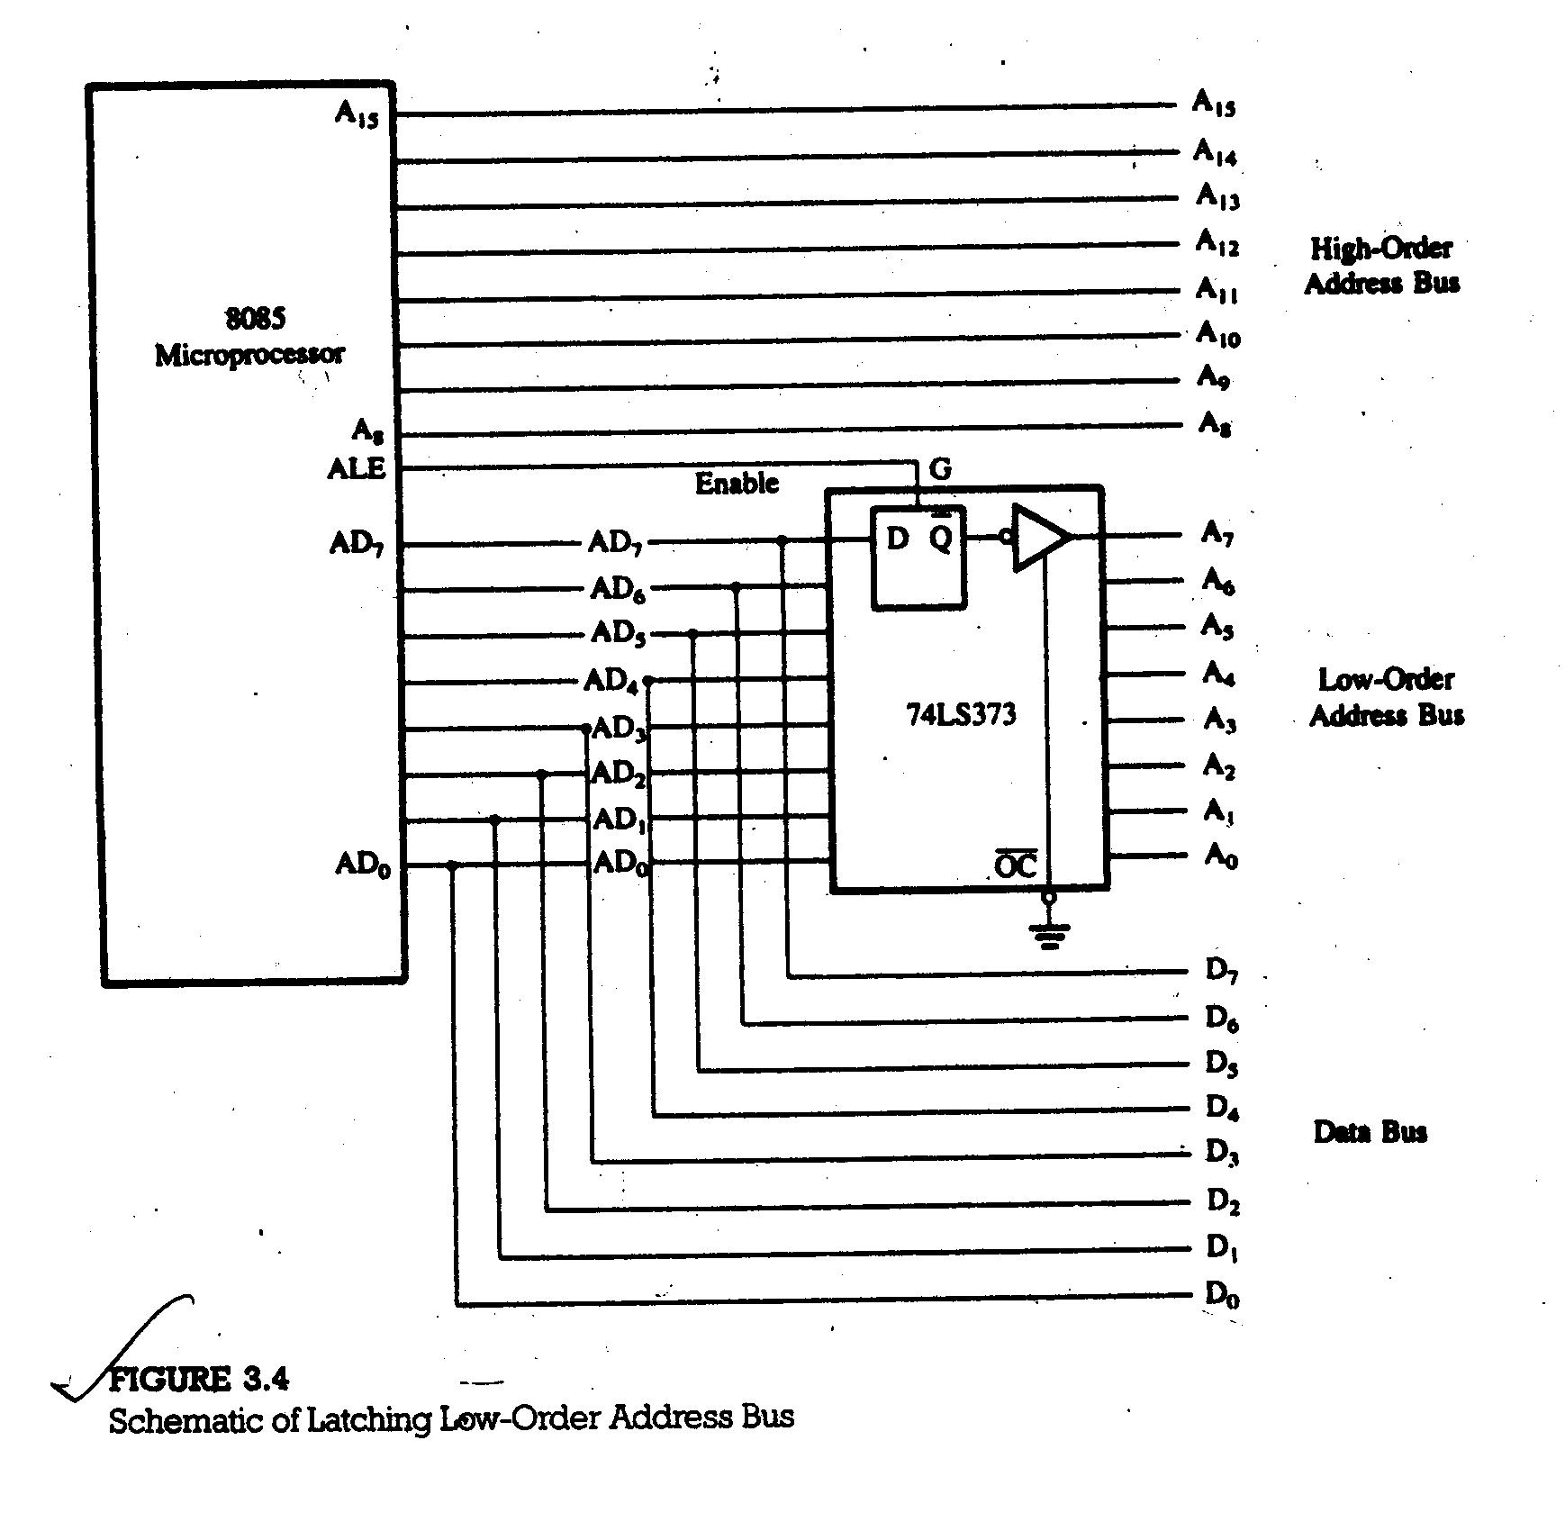

Slide 12
Figure 3.3 shows that when the ALE is high (at T₁), the latch is transparent; this means the output changes according to the input data (05H).
When the ALE goes low, the data 05H is latched until the ALE becomes high again.
3.14 Generating Control Signals
Figure 3.5 shows that four control signals are generated by combining RD, WR, and IO/M.

Slide 13
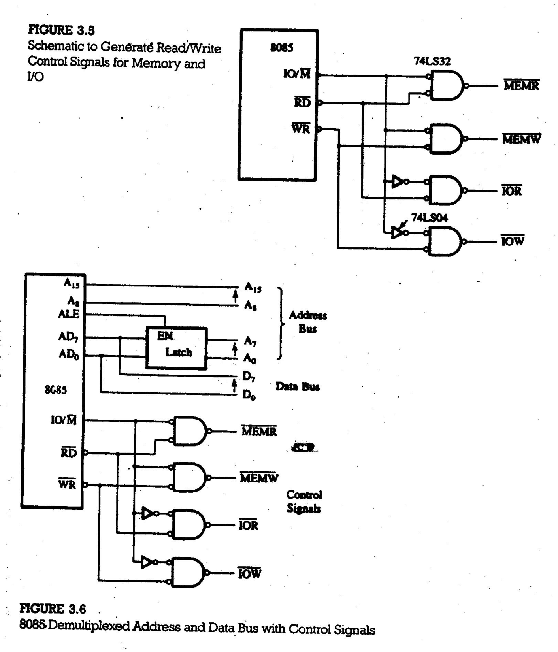

Slide 14
3.21 The 8085 Machine Cycles and Bus Timing
To execute an instruction, 8085 needs to complete an instruction cycle. An instruction cycle is consisted of one or more machine cycles. A machine cycle is again consisted of two or more clock periods (T-states).
Instruction cycle = Fetch cycle + Execution cycle
Fetch cycle = Opcode fetch (from memory)
Execution cycle = Opcode decode (in CPU) + Operand fetch [if necessary] (from memory) + Execution (in CPU) + Store back [optional] (to memory)

Slide 15
Instruction Cycle
Fetch Cycle
Execution Cycle
Opcode
Fetch
Instruction
Decode
Operand
Fetch
Execution
Store back
M₁
M₁
M₁
M₁
M₂
T₁
T₂
T₃
T₄
T₁
T₂
T₁
T₂
T₃
T₄
T₁
T₂
T₃
T₁
T₂

Slide 16
3.22 Opcode Fetch Machine Cycle
To execute any instruction, 8085 at first fetches the opcode of the instruction and it requires a single machine cycle. In Figure 3.3 we have seen how the opcode 4FH (MOV C,A) is fetched from memory location 2005H.
3.23 Memory Read Machine Cycle (Operands-Data/Address)
In Figure 3.3 the instruction MOV C,A is a 1-byte instruction and only the opcode is fetched from memory, no operand (data or address) is read from memory. For an instruction which is more than 1-byte a further memory read operation is needed for operand(s) [data or address].
Example: The machine codes-00111110 (3EH-MVI A) and 00110010 (32H) – are stored in memory locations: 2000H and 2001H.
Memory Location Machine Code Hex Instruction
2000H 00111110 3EH MVI A,32H
2001H 00110010 32H

Slide 17
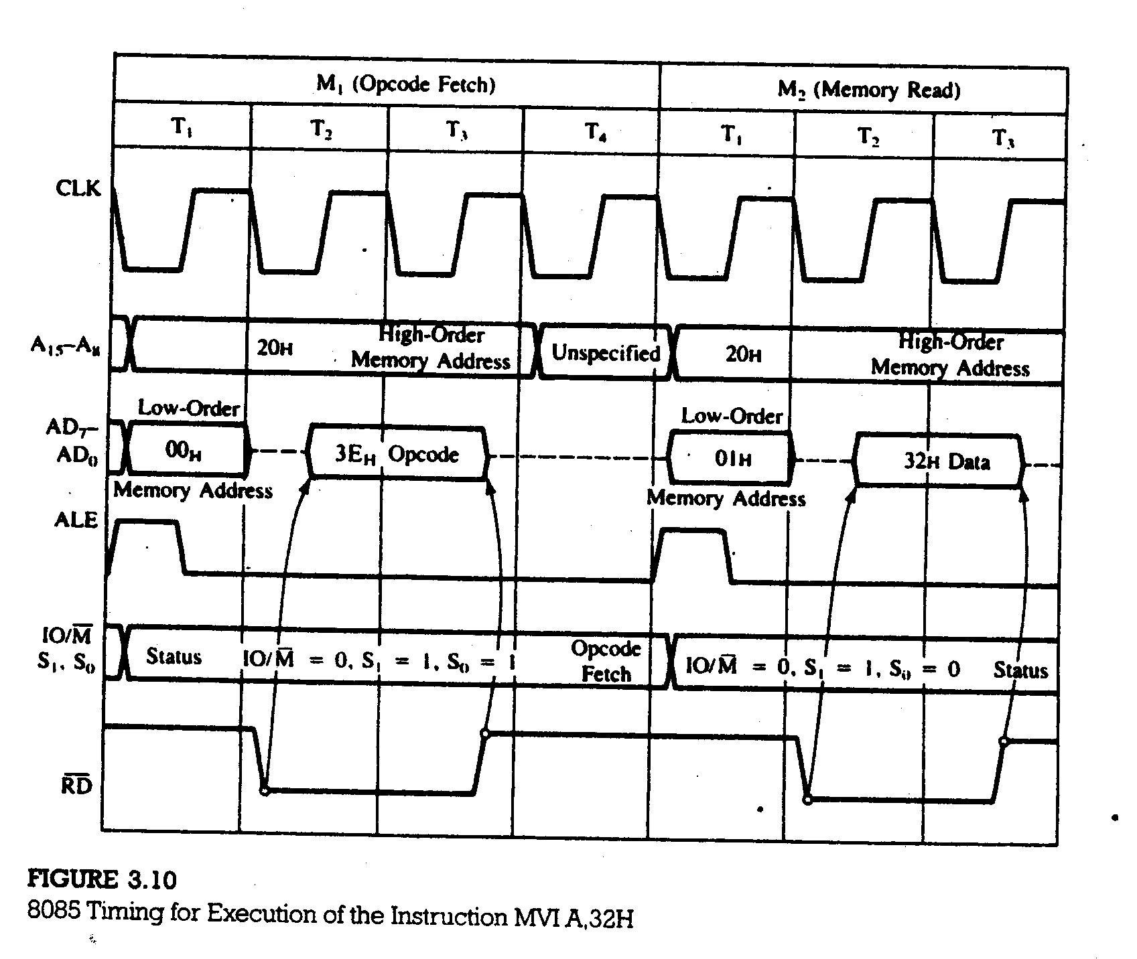

Slide 18
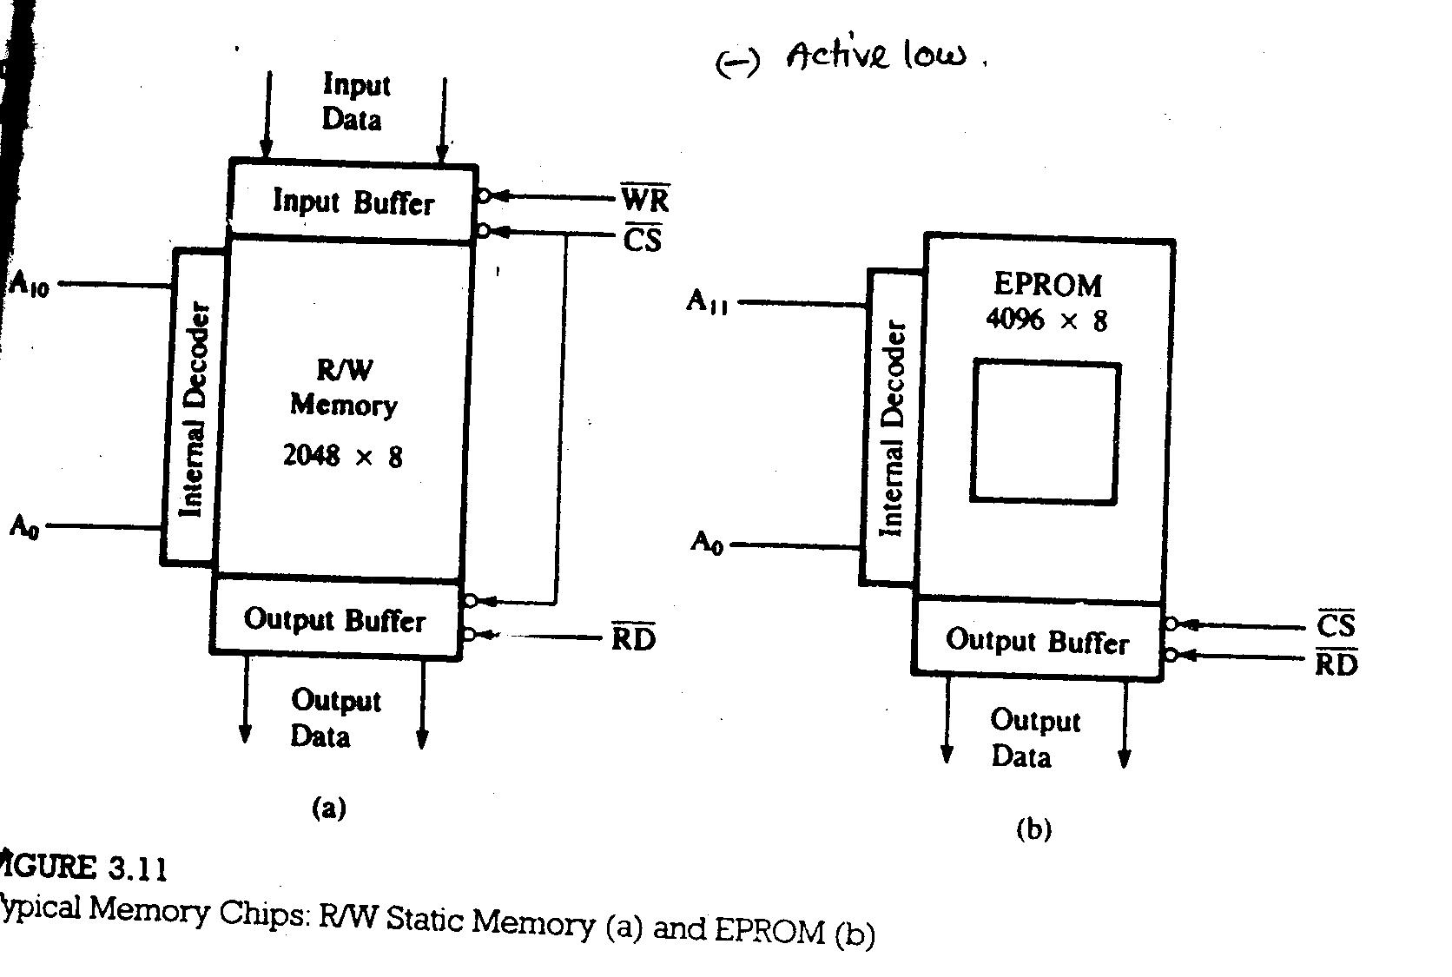
3.3 MEMORY INTERFACING

Slide 19
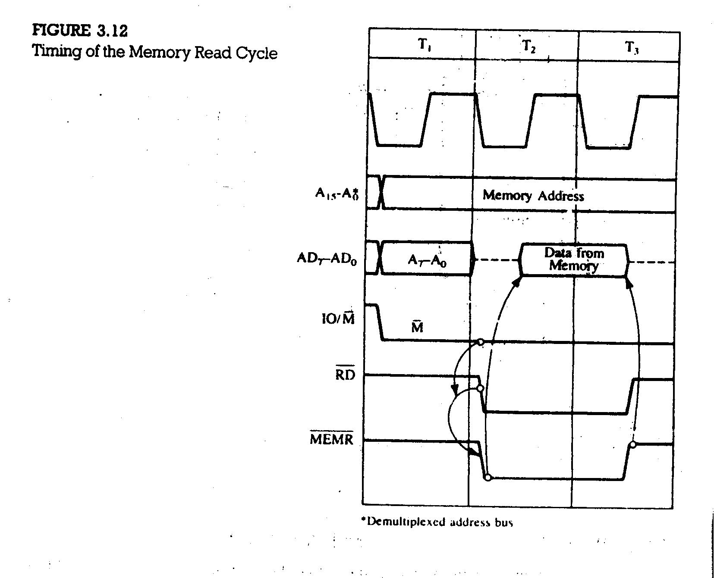

Slide 20
